Slide 1
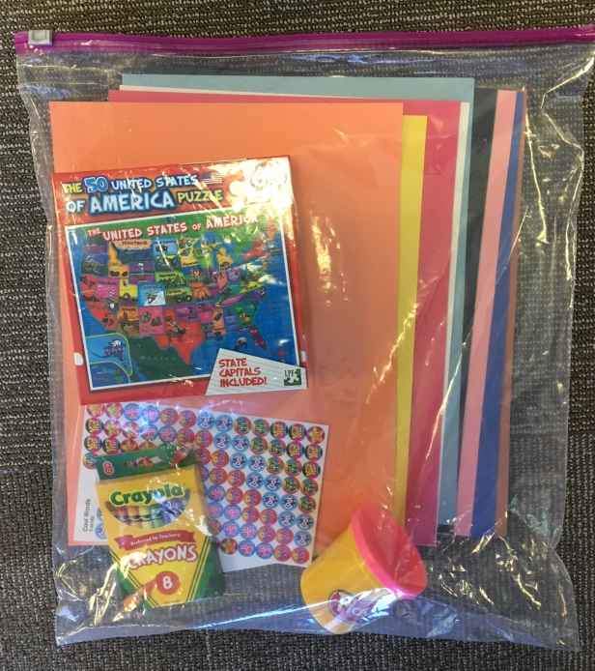
Craft Kit Examples:
Painting kit: include small paint set with brush and thin canvas (4x4 or 4x6)
Figurine kit: include a figurine and paint set
Magic wand kit: include paper wand, markers, stickers
Model Magic or Playdoh for freestyle play
Tissue paper flowers: various colors of tissue paper, green felt for stems
Pet rock: rock, paint pens
Paper bag animals: brown paper bags, markers, animal stickers

